Slide 1

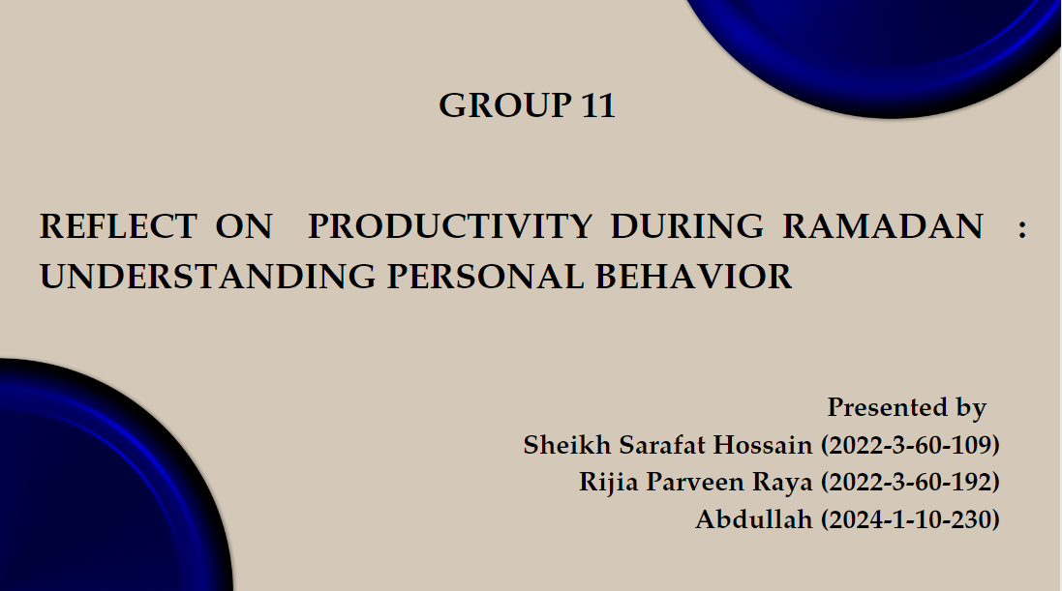

n.
GROUP 11
REFLECT ON PRODUCTIVITY DURING RAMADAN
: UNDERSTANDING PERSONAL BEHAVIOR
Presented by
Sheikh Sarafat Hossain (2022-3-60-109)
Rijia Parveen Raya (2022-3-60-192)
Abdullah (2024-1-10-230)

Slide 2



n.
INTRODUCTION
Ramadan is a sacred month observed by Muslims worldwide
It is characterized by fasting , prayer, spiritual growth and act of charity .
Beyond its religious significance, Ramadan has a noticeable changes on Muslims' daily routines, behaviors, and productivity.

Slide 3


OBJECTIVE
Analyzing personal productivity patterns during the month of Ramadan helps to understand how people manage their time, handle tasks, and energy levels while fasting.
Additionally, various factors such as - Sleep patterns, Routine Disruption, Mental focus, Time management affect individuals' ability to maintain efficiency and effectiveness in their daily activities.
METHODOLOGY
During Ramadan, “Self-reflection” means thinking about your actions and behavior to become a better person. It's like looking at yourself in a mirror and seeing what you can improve.
Observing personal behavior during Ramadan means paying attention to how you act and interact with others, with the goal of being more mindful and considerate.

Slide 4
A comparison chart illustrating productivity levels
During Ramadan VS Other months:
Aspect | Other months | During Ramadan
Productivity level | Normal to high | Normal to low
Energy levels | Generally stable | Up and down due to fasting
Focus and concentration | Generally stable | Decrease due to hunger and fatigue
Work hours | Regular working hours | Adjusted for fasting
Task completion rate | Normal | Slower due to reduced energy
Social interactions | Unaffected | Adjusted for religious activities
Stress levels | Manageable | Increase due to fasting and changes in routine

Slide 5

FACTORS INFLUNCING PRODUCTIVITY
DURING RAMADAN
1. Fasting : How fasting affects energy levels and focus.
2. Sleep Patterns : Changes in sleep schedules due to altered meal times.
3. Routine Disruption : Adjustments to daily routine for prayer and meals.
4. Mental Focus : Effects of spiritual reflection and increased mindfulness.
5. Time Management : Prioritization of tasks around prayer times and fasting.

Slide 6



PERSONAL OBSERVATIONS AND EXPERIENCES
STUDENTS:
HOUSEHOLD :
Fatigue and reduced energy levels
Difficulty in concentration due to hunger and thirst
Time management challenges
Balancing academic commitments
Impact on extracurricular activities.
Cooking and meal preparation for suhoor and iftar
Disrupted sleep patterns
Behavioral changes such as patience, generosity, and avoiding conflicts
Prioritizing acts of charity and goodwill.
Managing time for reading the Qur'an, performing Taraweeh prayers.
Shift in operating hours and extended hours for iftar and suhoor
Offering Ramadan special menu
Staffing and workload schedule changes
offer special deals or promotions to attract customers for group gatherings.
RES﻿TRAUNTS:

Slide 7
RESULTS
MORE
OR
LESS PRODUCTIVE?
Ramadan makes us more or less productive depends on how individuals adapt to fasting and integrate religious observances into their daily lives. With proper planning, self-care, and support from employers or academic institutions, individuals can strive to maintain or even enhance their productivity during this sacred month.
Changes in productivity:
•Productivity varies on changes in routine due to fasting.
•An individual might feel less focused due to the daytime fasting,specially the students.
•Taking enough rest and sleeping during the night time properly is necessary for everyone.
• Time management changes which might cause one feel more pressurized and stressed.
DISCUSSION
Factors for more productivity:
•Job workers and students must take enough rests and proper sleep.
•Eating nutritious food which will provide more energy at daytime.
• Taking short breaks in middle of works.
•Students must learn to use the time efficiently.
•Do the works schedule wise.

Slide 8


CONCLUSION
Ramadan serves as a powerful reminder of the importance of self-awareness, discipline, and intentionality in all aspects of our lives. As we continue on our journey through this blessed month, let us strive to optimize our productivity, maximize our blessings, and draw closer to our creator.

Slide 9



Thank
Thank
you!
you!

